Slide 1
Design and Analysis of Algorithms
CS602
Lecture 4
Divide and Conquer Paradigm – III
- Multiplication of 2 Polynomials (1st algo)
- Finding Majority Element

Slide 2
Word RAM model of computation

Slide 3
RAM : a model of computation
Data
Processor
Program
RAM

Slide 4
Execution of a instruction
Processor
RAM

Slide 5
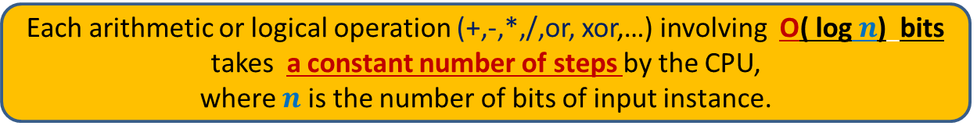
word RAM model of computation: Characteristics
Word is the basic storage unit of RAM. Word is a collection of few bytes.
Data as well as Program reside fully in RAM.
Each input item (number, name) is stored in binary format.
RAM can be viewed as a huge array of words. Any arbitrary location of
RAM can be accessed in the same time irrespective of the location.
Each arithmetic or logical operation (+,-,*,/,or, xor,…) involving a constant number of words takes a constant number of steps by the CPU.
Each arithmetic or logical operation (+,-,*,/,or, xor,…) involving O( log $n$) bits
takes a constant number of steps by the CPU,
where $n$ is the number of bits of input instance.
The justification for the word RAM model is given on the following slide.

Slide 6
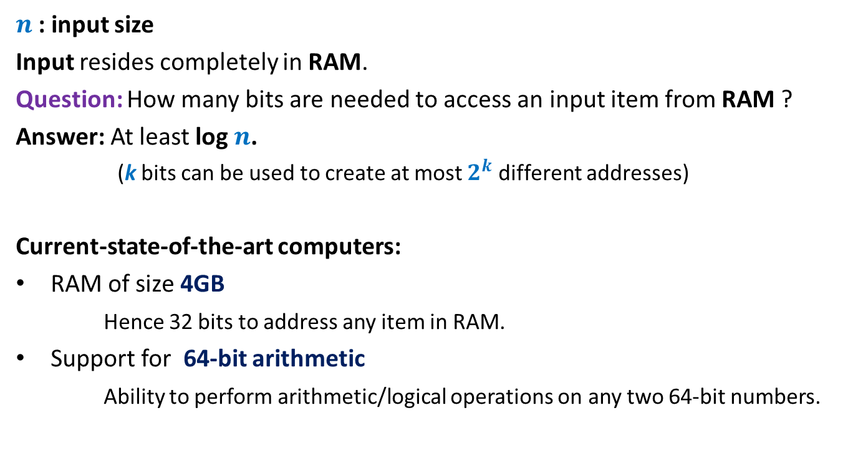
A more realistic RAM
$n$: input size
Input resides completely in RAM.
Question: How many bits are needed to access an input item from RAM ?
Answer: At least log $n$.
(k bits can be used to create at most $2^{k}$ different addresses)
Current-state-of-the-art computers:
RAM of size 4GB
Hence 32 bits to address any item in RAM.
Support for 64-bit arithmetic
Ability to perform arithmetic/logical operations on any two 64-bit numbers.

Slide 7
An algorithm for multiplying two polynomials
Problem 3

Slide 8
Multiplying two polynomials
Definition (polynomial of degree less than $n$)
$$A\left(x\right)=a_{0}+a_{1}x+a_{2}x^{2}+ …a_{n−1}x^{n−1}$$
Problem : Given two polynomial of degree less than $n$,
$$A\left(x\right)=a_{0}+a_{1}x+a_{2}x^{2}+ …a_{n−1}x^{n−1}$$
$$B\left(x\right)=b_{0}+b_{1}x+b_{2}x^{2}+ …b_{n−1}x^{n−1}$$
Compute $C=A × B$
$$C\left(x\right)=\sum_{0≤i<2n−1}{c_{i}x^{i}}$$
where $c_{i}$ =
Trivial algorithm: O( $n^{2}$)
Aim: O( $n$ $\log{n}$)
Applications:
Signal processing (Discrete Fourier Transform)
As practical as sorting and searching
Multiplication of two integers.
$$a_{0}b_{i}+a_{1}b_{i−1}+a_{2}b_{i−2}+ …+a_{i−1}b_{1}+a_{i}b_{0}$$
O($i$) time

Slide 9

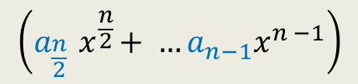


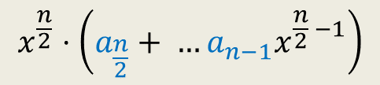

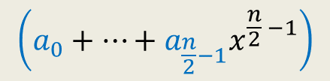

Divide Step
Attempt 1
$$A\left(x\right)=a_{0}+a_{1}x+a_{2}x^{2}+ …a_{n−1}x^{n−1}$$
$$A\left(x\right)= ? + ?$$
$$A\left(x\right)=A_{first}\left(x\right)+{ x}^{\frac{n}{2}} A_{second}\left(x\right)$$
$$\left(a_{0}+…+a_{\frac{n}{2}−1}x^{\frac{n}{2} −1}\right)$$
$$x^{\frac{n}{2}}⋅\left(a_{\frac{n}{2}}+ …a_{n−1}x^{\frac{n}{2} −1}\right)$$
$$\left(a_{\frac{n}{2}}{ x}^{\frac{n}{2}}+ …a_{n−1}x^{n −1}\right)$$
First $\frac{n}{2}$ terms of $A\left(x\right)$
Last $\frac{n}{2}$ terms of $A\left(x\right)$
$$A_{first}\left(x\right)$$
$$A_{second}\left(x\right)$$
Notes:
We can evaluate x^{n/2} in log n time for any given value of x: by repeated squaring:
For example, to compute x^1024, we compute and square x^512.
To compute x^512, we compute and square x^128.
To compute x^128, we copute and square x^64
…
To compute x^2, we square x.
So just O(log n) arithmetic operations are needed.

Slide 10
Faster algorithm for
multiplying two integers

Slide 11




Addition of two $n$-bit numbers
$$0$$ | $$0$$ | $$0$$ | $$0$$ | $$0$$ | $$1$$ | $$0$$ | $$0$$ | $$0$$ | $$1$$ | $$1$$ | $$1$$ | $$0$$ | $$1$$ | $$0$$ | $$1$$
$$X$$
$$+$$
$$0$$ | $$0$$ | $$1$$ | $$0$$ | $$1$$ | $$1$$ | $$0$$ | $$0$$ | $$0$$ | $$1$$ | $$0$$ | $$1$$ | $$0$$ | $$0$$ | $$1$$ | $$0$$
$$Y$$

Slide 12


$$1$$
$$0$$ | $$0$$ | $$0$$ | $$0$$ | $$0$$ | $$1$$ | $$0$$ | $$0$$ | $$0$$ | $$1$$ | $$1$$ | $$1$$ | $$0$$ | $$1$$ | $$0$$ | $$1$$
$$X$$
$$+$$
$$0$$ | $$0$$ | $$1$$ | $$0$$ | $$1$$ | $$1$$ | $$0$$ | $$0$$ | $$0$$ | $$1$$ | $$0$$ | $$1$$ | $$0$$ | $$0$$ | $$1$$ | $$0$$
$$Y$$
 |  |  |  |  |  |  |  |  |  |  |  | $$0$$ | $$1$$ | $$1$$ | $$1$$
$$0$$

Slide 13
$$1$$
$$0$$ | $$0$$ | $$0$$ | $$0$$ | $$0$$ | $$1$$ | $$0$$ | $$0$$ | $$0$$ | $$1$$ | $$1$$ | $$1$$ | $$0$$ | $$1$$ | $$0$$ | $$1$$
$$X$$
$$+$$
$$0$$ | $$0$$ | $$1$$ | $$0$$ | $$1$$ | $$1$$ | $$0$$ | $$0$$ | $$0$$ | $$1$$ | $$0$$ | $$1$$ | $$0$$ | $$0$$ | $$1$$ | $$0$$
$$Y$$
 |  |  |  |  |  |  |  |  |  |  |  | $$0$$ | $$1$$ | $$1$$ | $$1$$
$$0$$
$$0$$

Slide 14


$$1$$
$$0$$ | $$0$$ | $$0$$ | $$0$$ | $$0$$ | $$1$$ | $$0$$ | $$0$$ | $$0$$ | $$1$$ | $$1$$ | $$1$$ | $$0$$ | $$1$$ | $$0$$ | $$1$$
$$X$$
$$+$$
$$0$$ | $$0$$ | $$1$$ | $$0$$ | $$1$$ | $$1$$ | $$0$$ | $$0$$ | $$0$$ | $$1$$ | $$0$$ | $$1$$ | $$0$$ | $$0$$ | $$1$$ | $$0$$
$$Y$$
 |  |  |  |  |  |  |  |  |  |  |  | $$0$$ | $$1$$ | $$1$$ | $$1$$
$$1$$
$$0$$
$$0$$

Slide 15

$$0$$ | $$0$$ | $$0$$ | $$0$$ | $$0$$ | $$1$$ | $$0$$ | $$0$$ | $$0$$ | $$1$$ | $$1$$ | $$1$$ | $$0$$ | $$1$$ | $$0$$ | $$1$$
$$X$$
$$+$$
$$0$$ | $$0$$ | $$1$$ | $$0$$ | $$1$$ | $$1$$ | $$0$$ | $$0$$ | $$0$$ | $$1$$ | $$0$$ | $$1$$ | $$0$$ | $$0$$ | $$1$$ | $$0$$
$$Y$$
$$0$$ | $$0$$ | $$1$$ | $$1$$ | $$0$$ | $$0$$ | $$0$$ | $$0$$ | $$1$$ |  |  |  | $$0$$ | $$1$$ | $$1$$ | $$1$$
$$1$$
$$0$$
$$0$$
O($n$) time

Slide 16












Multiplication of of two $n$-bit numbers
$$1$$ | $$0$$ | $$1$$ | $$1$$ | $$1$$ | $$0$$ | $$1$$ | $$1$$
$$X$$
$$×$$
$$0$$ | $$0$$ | $$1$$ | $$0$$ | $$0$$ | $$1$$ | $$0$$ | $$1$$
$$Y$$
$$1$$ | $$0$$ | $$1$$ | $$1$$ | $$1$$ | $$0$$ | $$1$$ | $$1$$
$$0$$ | $$0$$ | $$0$$ | $$0$$ | $$0$$ | $$0$$ | $$0$$ | $$0$$ | 0
$$+$$
$$1$$ | $$0$$ | $$1$$ | $$1$$ | $$1$$ | $$0$$ | $$1$$ | $$1$$ | 0 | 0
$$0$$ | $$0$$ | $$0$$ | $$0$$ | $$0$$ | $$0$$ | $$0$$ | $$0$$ | $$0$$ | $$0$$ | $$0$$
O($n^{2}$) time

Slide 17




Multiplying a number $X$ by $2^{i}$
$$1$$ | $$0$$ | $$1$$ | $$1$$ | $$1$$ | $$0$$ | $$1$$ | $$1$$
$$X$$
$$×$$
$$0$$ | $$0$$ | $$1$$ | $$0$$ | $$0$$ | $$0$$ | $$0$$ | $$0$$
$$2^{i}$$
$$1$$ | $$0$$ | $$1$$ | $$1$$ | $$1$$ | $$0$$ | $$1$$ | $$1$$ | $$0$$ | $$0$$ | $$0$$ | $$0$$ | $$0$$
O($i$) time

Slide 18

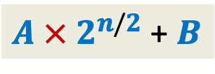










Pursuing Divide and Conquer approach
MSB
LSB
Question: how to express $X×Y$ in terms of multiplication/addition of {$A,B,C,D$} ?
Hint: First Express $X$ and $Y$ in terms of {$A,B,C,D$}.
$X$ = ? and $Y$ = ? .
Hence …
$X×Y$ = ($A×C$ ) $×$ ?? $+$ ($A×D$ + $B×C$ ) $×$ ?? + $B×D$
$$A$$
$$B$$
$$X$$
n-1 n-2…......………………n/2.............................2 1 0
$$×$$
$4$multiplications
$$C$$
$$D$$
$$Y$$
$A$ $×$ $2^{n/2}$ + $B$
$C$ $×$ $2^{n/2}$ $+$ $D$
$$2^{n}$$
$$2^{n/2}$$

Slide 19



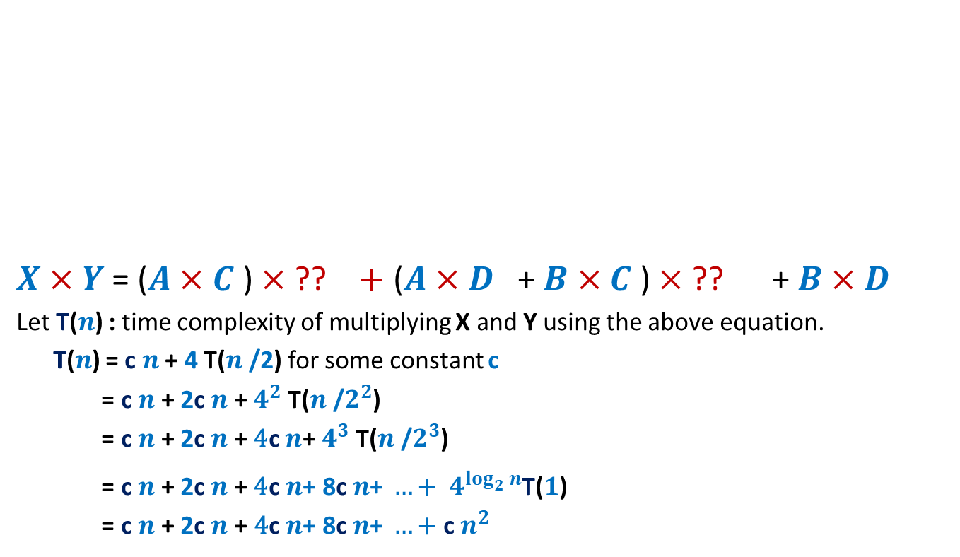




Pursuing Divide and Conquer approach
MSB
LSB
$X×Y$ = ($A×C$ ) $×$ ?? $+$ ($A×D$ + $B×C$ ) $×$ ?? + $B×D$
Let T($n$) : time complexity of multiplying X and Y using the above equation.
T($n$) = c $n$ + 4 T($n$/2) for some constant c
= c $n$ + 2c $n$ + $4^{2}$ T($n$/$2^{2}$)
= c $n$ + 2c $n$ + ${\text{4}\text{c} n\text{+} 4}^{3}$ T($n$/$2^{3}$)
= c $n$ + 2c $n$ + ${\text{4}\text{c} n\text{+ 8}\text{c} n\text{+ }…+ 4}^{\log_{2}^{}n}$T($1$)
= c $n$+ 2c $n$+ ${\text{4}\text{c} n\text{+ 8}\text{c} n\text{+ }…+\text{c} n}^{2 }$
$$A$$
$$B$$
X
n-1 n-2…......………………n/2.............................2 1 0
$$×$$
$$C$$
$$D$$
Y
$$2^{n}$$
$$2^{n/2}$$
O($n^{2}$) time algo

Slide 20



Pursuing Divide and Conquer approach
MSB
LSB
$X×Y$ = ($A×C$ ) $×$ ?? $+$ ($A×D$ + $B×C$ ) $×$ ?? + $B×D$
Can we do it ?
$$A$$
$$B$$
X
n-1 n-2…......………………n/2.............................2 1 0
$$×$$
$$C$$
$$D$$
Y
$$2^{n}$$
$$2^{n/2}$$
Can we compute it using only one multiplication ?
Hint: use the fact that we can add and subtract efficiently. And we have already computed …
$4$ Multiplications
$3$ Multiplications

Slide 21






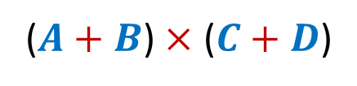


Pursuing Divide and Conquer approach
MSB
LSB
$X×Y$ = ($A×C$ ) $×$ ?? $+$ ($A×D$ + $B×C$ ) $×$ ?? + $B×D$
($A×D$ + $B×C$)
$$A$$
$$B$$
$$X$$
n-1 n-2…......………………n/2.............................2 1 0
$$×$$
$$C$$
$$D$$
$$Y$$
$$2^{n}$$
$$2^{n/2}$$
$$A×C$$
$$+$$
$$+$$
$$B×D$$
$$=$$
($A+B$) $×$ ($C+D$)

Slide 22





Pursuing Divide and Conquer approach
MSB
LSB
$X×Y$ = ($A×C$ ) $×$ ?? $+$ ($A×D$ + $B×C$ ) $×$ ?? + $B×D$
($A×D$ + $B×C$)
$$A$$
$$B$$
$$X$$
n-1 n-2…......………………n/2.............................2 1 0
$$×$$
$$C$$
$$D$$
$$Y$$
$$2^{n}$$
$$2^{n/2}$$
$$=$$
($A+B$) $×$ ($C+D$)
Each of these terms could be $\frac{n}{2}+1$bit long. What to do ?
$$−$$
$$A×C$$
$$−$$
$$B×D$$

Slide 23



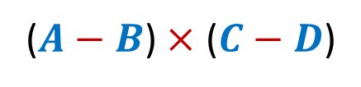

Pursuing Divide and Conquer approach
MSB
LSB
$X×Y$ = ($A×C$ ) $×$ ?? $+$ ($A×D$ + $B×C$ ) $×$ ?? + $B×D$
($A×D$ + $B×C$)
$$A$$
$$B$$
$$X$$
n-1 n-2…......………………n/2.............................2 1 0
$$×$$
$$C$$
$$D$$
$$Y$$
$$2^{n}$$
$$2^{n/2}$$
$$A×C$$
$$−$$
$$+$$
$$B×D$$
$$=$$
($A−B$) $×$ ($C−D$)

Slide 24




Pursuing Divide and Conquer approach
MSB
LSB
$X×Y$ = ($A×C$ ) $×$ ?? $+$ ($A×D$ + $B×C$ ) $×$ ?? + $B×D$
($A×D$ + $B×C$)
$$A$$
$$B$$
$$X$$
n-1 n-2…......………………n/2.............................2 1 0
$$×$$
$$C$$
$$D$$
$$Y$$
$$2^{n}$$
$$2^{n/2}$$
$$−$$
$$=$$
($A−B$) $×$ ($C−D$)
$$−$$
$$A×C$$
$$−$$
$$B×D$$

Slide 25


Pursuing Divide and Conquer approach
MSB
LSB
$X×Y$ = ($A×C$ ) $×$ ?? $+$ ($A×D$ + $B×C$ ) $×$ ?? + $B×D$
($A×D$ + $B×C$)
$$A$$
$$B$$
$$X$$
n-1 n-2…......………………n/2.............................2 1 0
$$×$$
$$C$$
$$D$$
$$Y$$
$$2^{n}$$
$$2^{n/2}$$
$$=$$
$$−$$
($A−B$) $×$ ($C−D$)
$$+$$
$$A×C$$
$$+$$
$$B×D$$

Slide 26
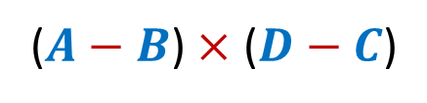

Pursuing Divide and Conquer approach
MSB
LSB
$X×Y$ = ($A×C$ ) $×$ ?? $+$ ($A×D$ + $B×C$ ) $×$ ?? + $B×D$
($A×D$ + $B×C$)
$$A$$
$$B$$
$$X$$
n-1 n-2…......………………n/2.............................2 1 0
$$×$$
$$C$$
$$D$$
$$Y$$
$$2^{n}$$
$$2^{n/2}$$
$$=$$
($A−B$) $×$ ($D−C$)
Each of these terms is surely $\frac{n}{2}$bit long. Good ☺
$$+$$
$$A×C$$
$$+$$
$$B×D$$

Slide 27




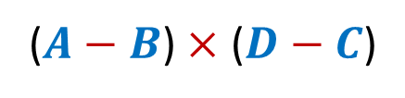


Pursuing Divide and Conquer approach
MSB
LSB
$X×Y$ = ($A×C$ ) $×$ ?? $+$ ($A×D$ + $B×C$ ) $×$ ?? + $B×D$
($A×D$ + $B×C$)
$$A$$
$$B$$
$$X$$
n-1 n-2…......………………n/2.............................2 1 0
$$×$$
$$C$$
$$D$$
$$Y$$
$$2^{n}$$
$$2^{n/2}$$
$$=$$
($A−B$) $×$ ($D−C$)
$$+$$
$$A×C$$
$$+$$
$$B×D$$
$4$ Multiplications
$3$ Multiplications
Using $2$ Subtractions and 2 more additions

Slide 28

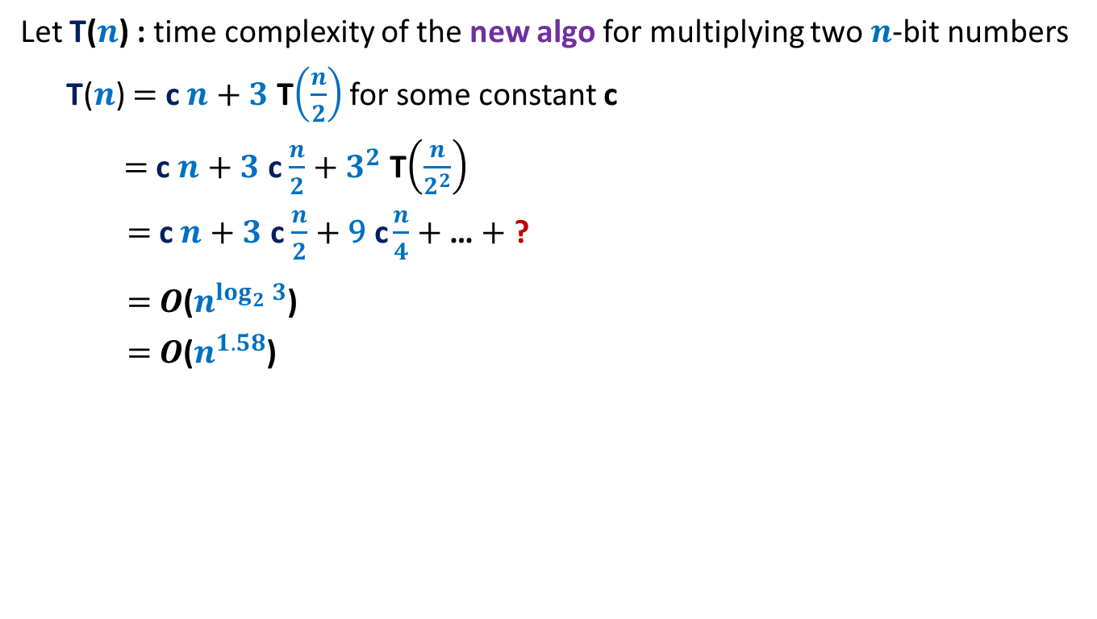
Pursuing Divide and Conquer approach
Let T($n$) : time complexity of the new algo for multiplying two $n$-bit numbers
T($n$) $=$ c $n$ $+$ $3$ T$\left(\frac{n}{2}\right)$ for some constant c
$=$ c $n$ $+$ $3$ c $\frac{n}{2}$ $+$ $3^{2}$ T$\left(\frac{n}{2^{2}}\right)$
$=$ c $n$ $+$ $3$ c $\frac{n}{2}$ $+$ $\text{9} \text{c}\frac{n}{4}$ $+$… $+$ ?
$=$ $O$($n^{\log_{2}^{}3}$)
$=$ $O$($n^{1.58}$)
$3^{\log_{2}^{}n}$ T($1$)

Slide 29
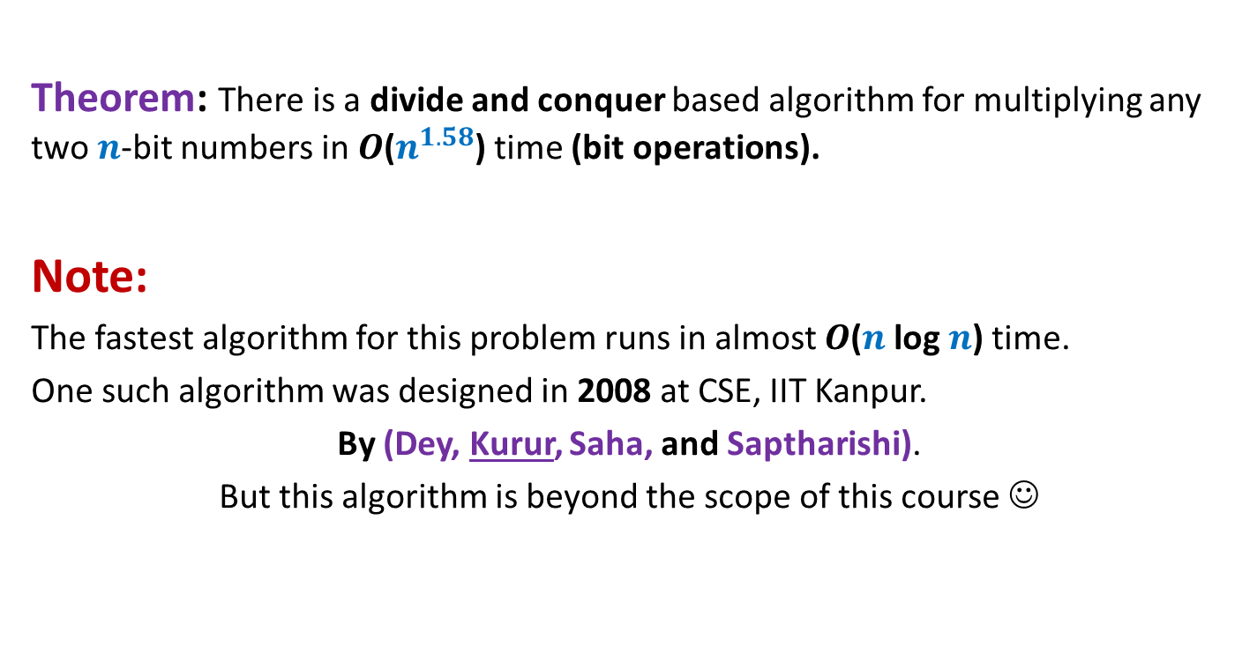
Conclusion
Theorem: There is a divide and conquer based algorithm for multiplying any two $n$-bit numbers in $O$($n^{1.58}$) time (bit operations).
Note:
The fastest algorithm for this problem runs in almost $O$($n$ log $n$) time.
One such algorithm was designed in 2008 at CSE, IIT Kanpur.
By (Dey, Kurur, Saha, and Saptharishi).
But this algorithm is beyond the scope of this course ☺

Slide 30

Homework
Design a divide and conquer based algorithm for multiplying
any two polynomials of degree less than $n$in $O$($n^{1.58}$) time.

Slide 31

Majority element
Definition: Given a multiset $S$ of $n$ elements,
$x∈ S$ is said to be majority element if it appears more than $n/2$ times in $S$.
$S$ = {$a,b,d,z,b,w,b,b,z,b,b,b,b,c$}

Slide 32

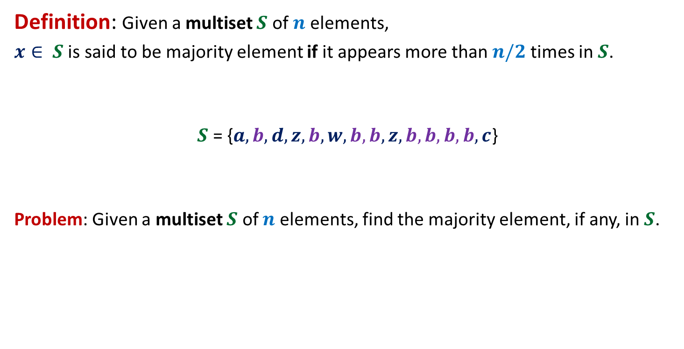
Majority element
Definition: Given a multiset $S$ of $n$ elements,
$x∈ S$ is said to be majority element if it appears more than $n/2$ times in $S$.
$S$ = {$a,b,d,z,b,w,b,b,z,b,b,b,b,c$}
Problem: Given a multiset $S$ of $n$ elements, find the majority element, if any, in $S$.
$$8$$

Slide 33

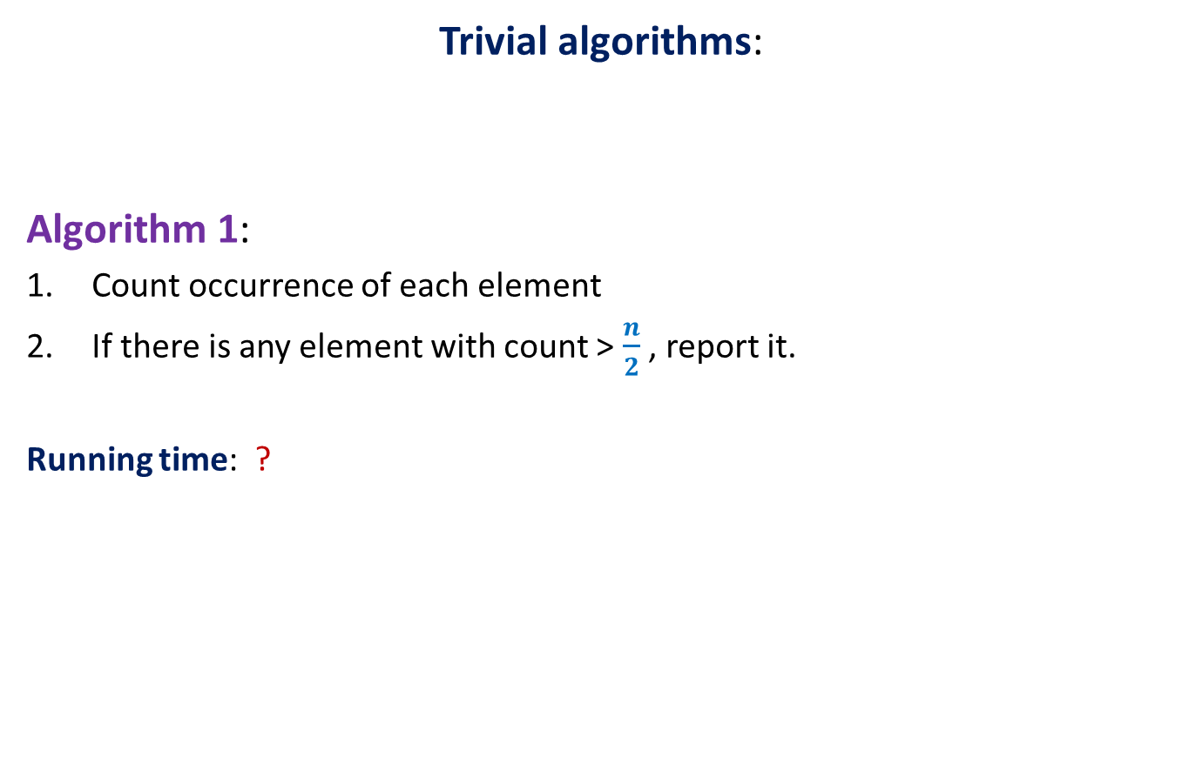
Majority element
Trivial algorithms:
Algorithm 1:
Count occurrence of each element
If there is any element with count > $\frac{n}{2}$ , report it.
Running time: ?
O($n^{2}$) time

Slide 34

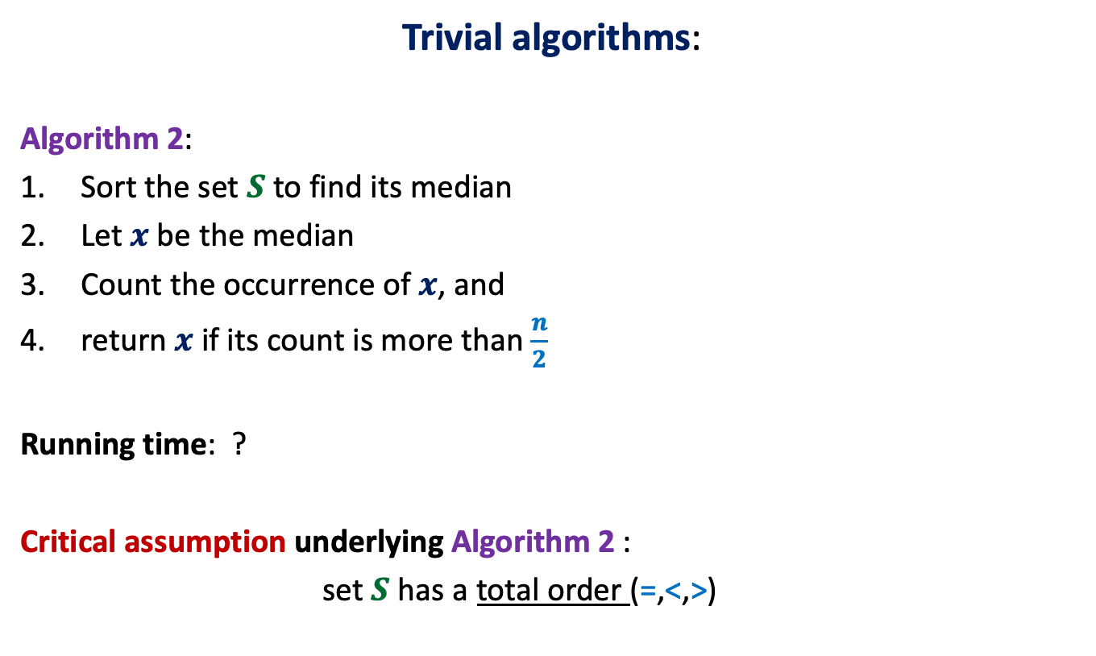
Majority element
Trivial algorithms:
Algorithm 2:
Sort the set $S$ to find its median
Let $x$be the median
Count the occurrence of $x$, and
return $x$ if its count is more than $\frac{n}{2}$
Running time: ?
Critical assumption underlying Algorithm 2 :
set $S$ has a total order (=,<,>)
This assumption is
not justified in many real life applications.
O($n log n$) time

Slide 35
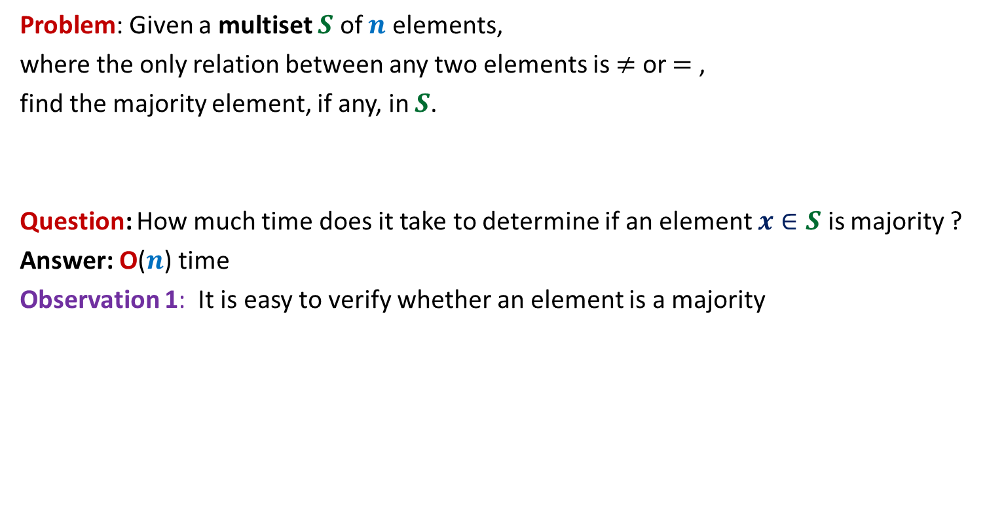
Some observations
Problem: Given a multiset $S$ of $n$ elements,
where the only relation between any two elements is $≠$ or $=$ ,
find the majority element, if any, in $S$.
Question: How much time does it take to determine if an element $x∈S$ is majority ?
Answer: O($n$) time
Observation 1: It is easy to verify whether an element is a majority

Slide 36


Some observations
Observation 2: whenever we cancel a pair of distinct elements from the array,
the majority element of the array remains preserved.
α
x
α
y
< $\frac{n}{2}$
> $\frac{n}{2}$
α
w
v
α
α
Majority
element
other
elements

Slide 37



Some observations
Observation 3: If there are $m$ pairs of identical elements, then
majority element among $2m$ elements is preserved
even if we keep one element per pair.
$a b c c c z c a b b c c c c d c$
$c c b b c c c c$
The problem size reduced by at least half.
$$c b c c$$

Slide 38

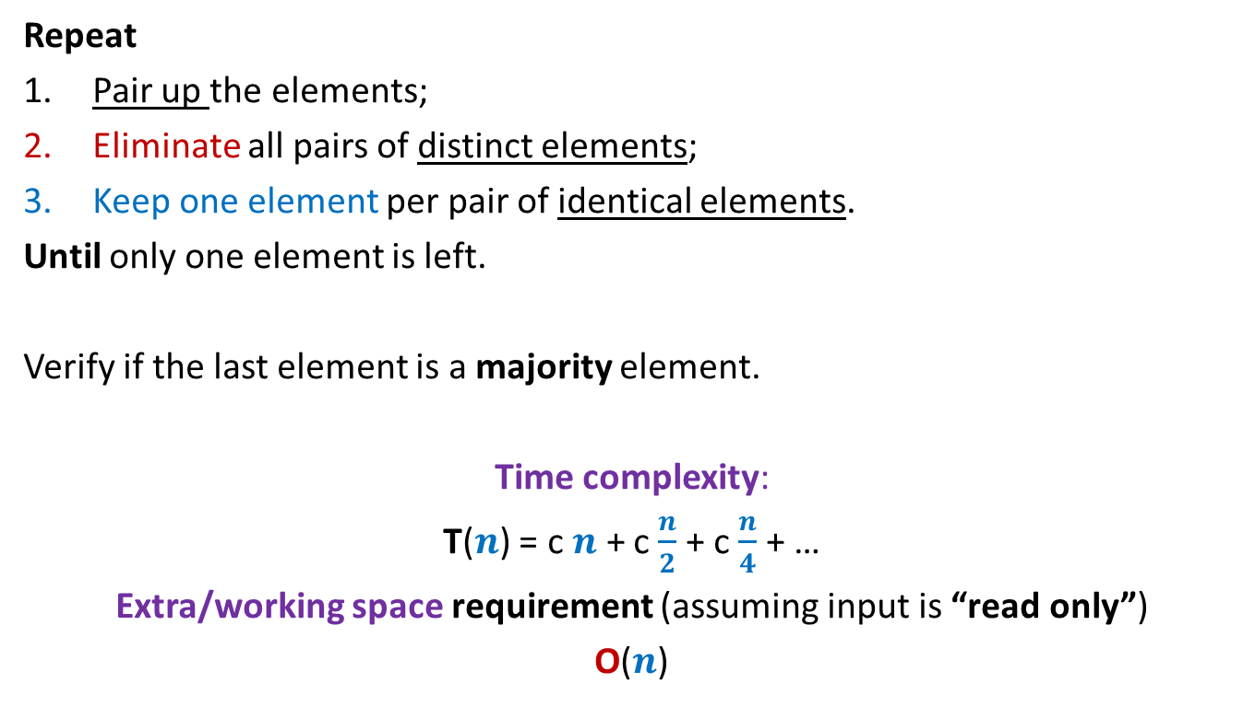
Algorithm for 2-majority element
Repeat
Pair up the elements;
Eliminate all pairs of distinct elements;
Keep one element per pair of identical elements.
Until only one element is left.
Verify if the last element is a majority element.
Time complexity:
T($n$) = c $n$ + c $\frac{n}{2}$ + c $\frac{n}{4}$ + …
Extra/working space requirement (assuming input is “read only”)
O($n$)
What if the no. of elements is odd ?
O($n$) time

Slide 39
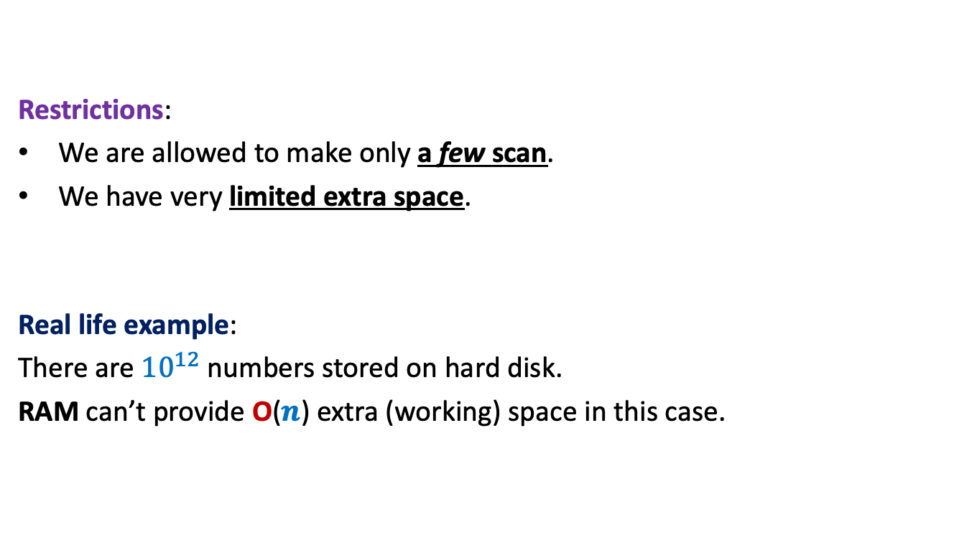
Further restrictions on the problem
Restrictions:
We are allowed to make only a few scan.
We have very limited extra space.
Real life example:
There are ${10}^{12}$ numbers stored on hard disk.
RAM can’t provide O($n$) extra (working) space in this case.
Our current algorithm doesn’t work
for this real life example.

Slide 40
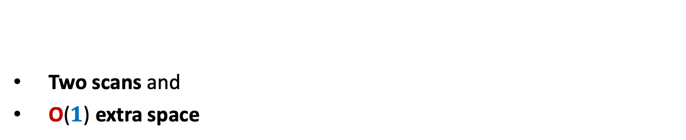
algorithm for 2-majority element
Homework
Two scans and
O($1$) extra space

